Slide 1
Job Portal
Presented By:
Hammad Hussain FA20-BSE-057
Arham Mazhar FA20-BSE-064
Muhammad Farhan FA20-BSE-066

Slide 2
Introduction:
The purpose of project is to provide fresh graduate a platform where they can apply in multiple organizations which will increase their recruiting chances. User can access the portal and can apply with some simple steps.
Job Search
Specific Logins/Dashboard
Quick Job application
Built In CV Options
Job related Options

Slide 3
1.
Problem statement:

Slide 4
Painful process of organizing job applications/cv’s
Multiple Candidates applying for one post/job
Skilled people are skipped in the process due to number of applications
Most feasible solution is to create a centralized system and put jobs their, This will ensure transparency among candidates and also they will be able to apply for various jobs using a single portal.

Slide 5
BIG CONCEPT
Platform to provide opportunity for job seekers.

Slide 6
2.
Req Phase:
Let’s start with the Second set of slides

Slide 7
Business Requirements
Development of Project
In LARAVEL 9
Comply to modern Web Architecture
Hosted on Free Webservice
Company will pay fee to use the system.

Slide 8
Functional Requirements
Admin & Candidate Dashboards.
Admin can Upload/Remove Jobs.
Admin & Candidate Authentication
Candidate can apply for Jobs.
Candidate can search for Jobs.
Candidate can register to use the system.

Slide 9
NON-Functional Requirements
Security
Portable
Reliable
Adaptable

Slide 10
3.
Design Phase:
Let’s start with the third set of slides

Slide 11
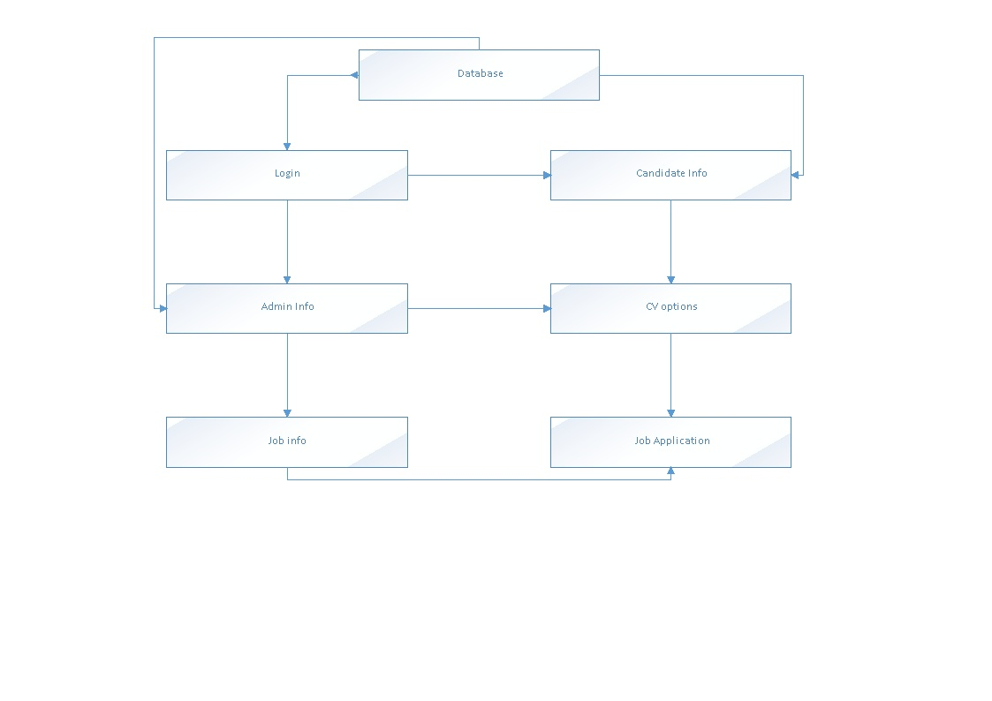
Block Diagram

Slide 12
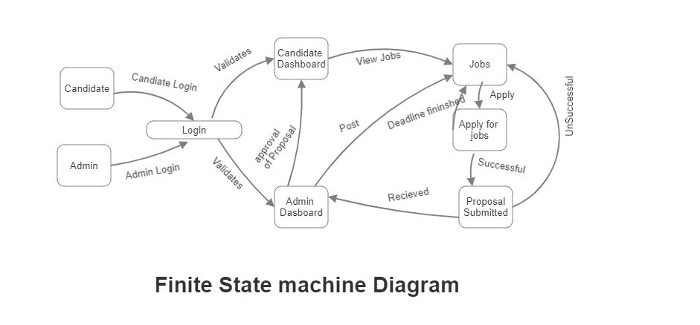
FSM

Slide 13
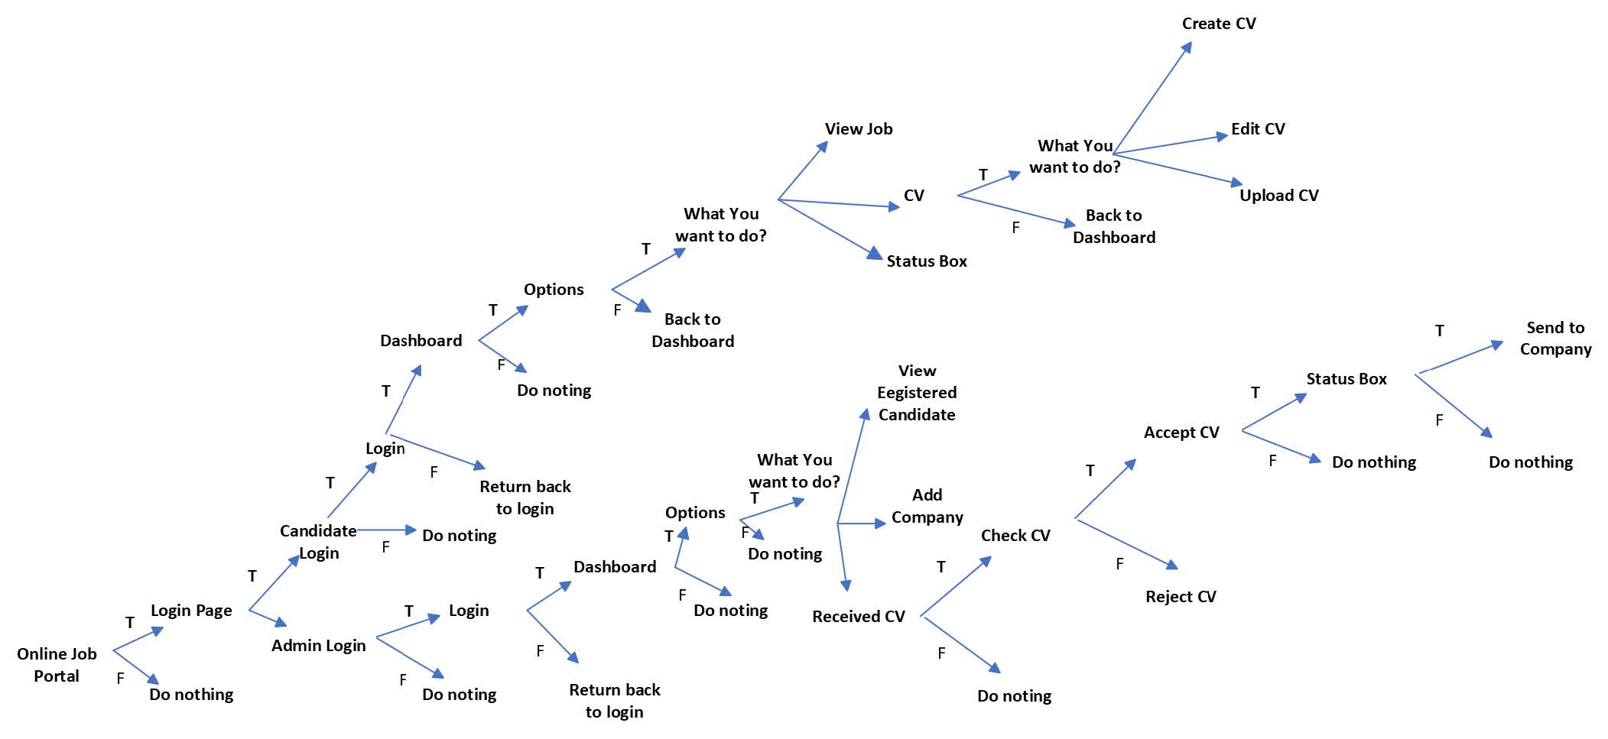
Decision Tree

Slide 14
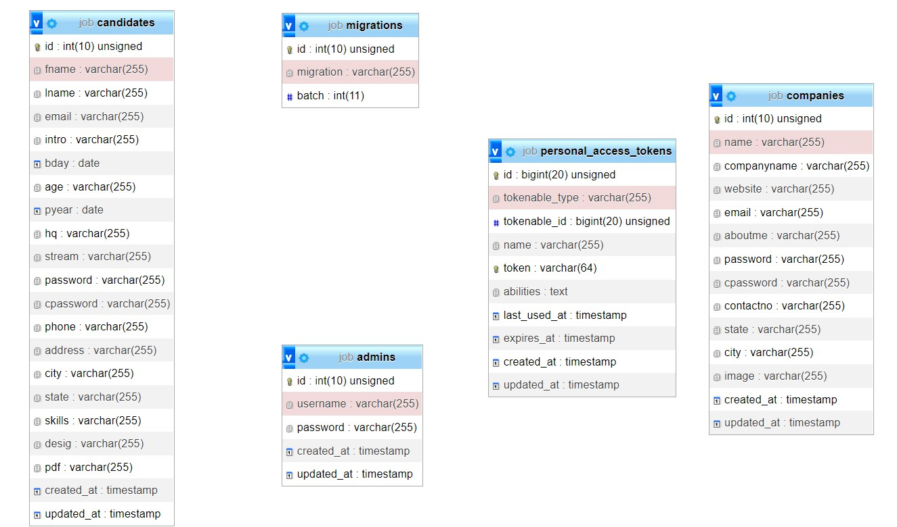
EER Diagram

Slide 15
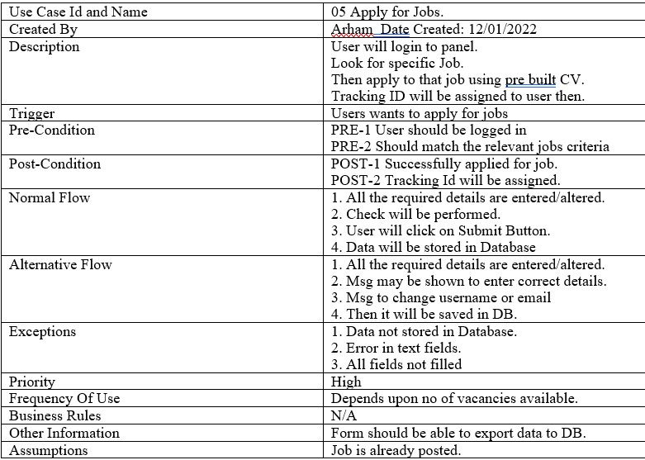
Fully Dressed USE CASE

Slide 16
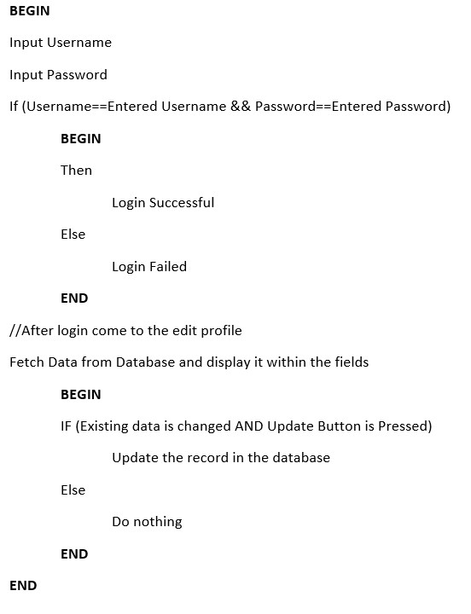
Pseudocode
Edit Module

Slide 17
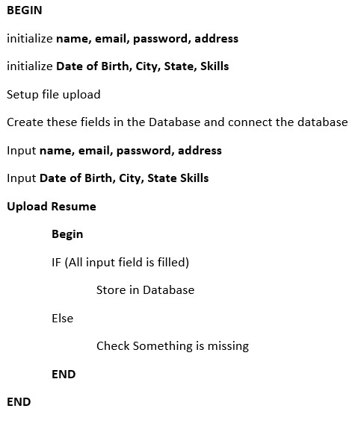
Pseudocode
Sign Up Module

Slide 18
4.
Helix Report:
Let’s start with the last set of slides

Slide 19
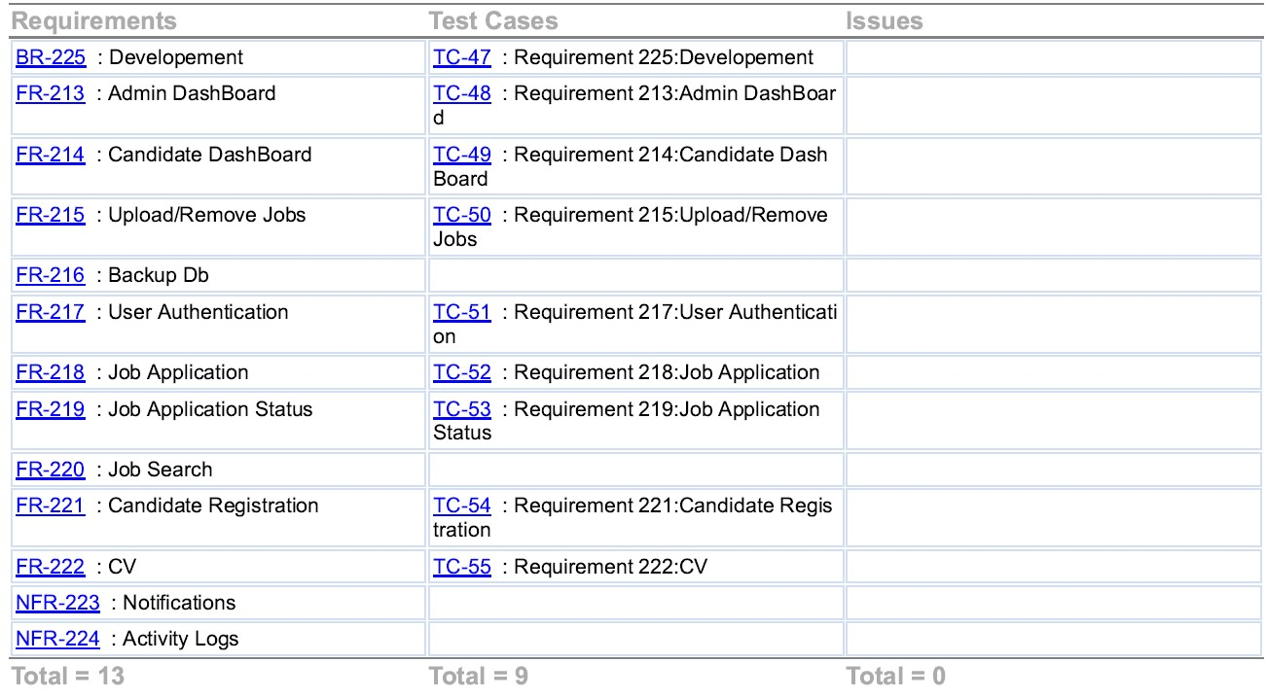
Traceability Matrix

Slide 20
Thanks!
Do you have any questions?

